Slide 1
Dysphonia
What A GP needs to know

Slide 2

This is my voice in May 2016 pre treatment

Slide 3
Definition
Hoarseness or dysphonia is a disorder of voice where vocal quality, pitch, loudness or effort is altered , thereby impairing communication or reducing voice – related quality of life.

Slide 4
Case Study
44yo female presents with hoarseness gradually worsening over the previous week to 10 days , more effort to speak an sounded subjectively “nervous”
History of moderate to severe runny nose (thought to be hay fever) in the previous weeks but no associated fever or cough.
Had tried oral antihistamines to try and “dry up” the feeling of choking – after a few days the dysphonia was suddenly worse.
What else do you want to know?

Slide 5
History
Preceding associated symptoms-
URTI, allergy eyes?, Laryngitis
Reflux
Neurological symptoms- Parkinson's disease, MS ,CVA symptoms, Myasthenia gravis
Metabolic – thyroid, acromegaly,
Malignancy and sarcoid – dysphagia, odynophagia, hemoptysis, stridor, weight loss/gain

Slide 6
History
Medications – inhaled corticosteroids , antipsychotics – causing dystonia of the larynx, ACE inhibitors- chronic cough , oral bisphosphonates causing reflux and laryngitis
Substance Hx – smoking, alcohol
Occupation – voice demands – teacher, doctor, sports coach, singer, clergy, lawyer, call centre operator, radio/TV

Slide 7
Examination
ENT exam – neck lumps, nodes, pharynx, tenderness of the neck, thyroid exam
Neuro – tremor

Slide 8
Case study
She’s a GP. Mother of 2. Coaches the under 7 boys soccer team once a week and games on Saturday
No asthma, hay fever and eczema always been mild
Minimal alcohol – glass of red 3 times a week, tea or coffee once a day, lifelong non smoker

Slide 9
What next ?
Laryngitis – acute and usually resolved by 2 weeks. Might wait and review in a week. Do you tell her NOT to use her voice ? YES
And give her a medical certificate
Stop all caffeine and alcohol ? Silent reflux – no evidence to prescribe if there are no symptoms of reflux.
Antibiotics ? NO
Steroids? NO

Slide 10
Case study
She returns after 2 weeks ( 4 weeks of dysphonia now). There is no change and she is worse.

Slide 11
What next ?
Refer to an ENT Dr for laryngoscopy and Speech therapist
Unilateral VC paralysis –” breathy”, tumour invasions compression of the Vagus nerve ( brainstem ,cervical or thoracic) and stroke
Benign VC lesions – cysts, nodules, polyps
Reflux – inflammation, mucosal oedema, contact ulcers and granuloma
Upon laryngoscopy - some inflammation about the cords

Slide 12
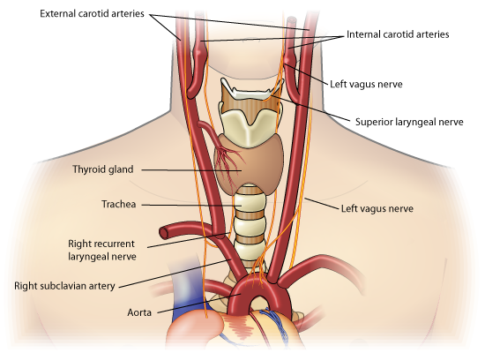
Anatomy of vagus

Slide 13
Case Study
Speech therapy once a week for next 8 weeks. Increased hydration, voice clearing technique – reverse candle blow
2nd look at cords and Skype with Melbourne voice clinic speech therapist. Also not sure so booked into Melbourne clinic but not available for 6 weeks!!
Trying to trick the voice, home exercises were hard and not seeming to make a great deal of difference,
Voice very quiet and using a microphone at work. Accessory muscles of the neck overworked. Tension headaches ++

Slide 14
Case Study
Strobe ( assesses the wave along the vocal cord) in Melbourne. Spasms noted in the adductor muscle and minor of the abductor. Saying 80-90
Reactively depressed . Socially withdrawn. Stopped coaching soccer. Cannot be heard at social events.
Diagnosis ??

Slide 15
Spasmodic Dysphonia
Rare – 30 per million
Unknown cause. 30% associated with a preceding URTI
Women more than men and 4th decade of life more common
Famous people- Jenny Morris, American cartoonist – Dilbert ( Scott Adams)
Treat with focal Botox injections – in the TA muscle (vocalis) for Ad SD and into the posterior CA For Ab SD ( more difficult injection ) .Indivualised ? Every 6 weeks to 3-6 months.
Voice therapy used in conjunction.
USA recurrent laryngeal nerve reimplantation surgery - new

Slide 16
Anatomy of VC
Functional anatomy of the vocal cords
The larynx, or voice box, has multiple intrinsic muscles that control movement of the vocal folds. All of these muscles are innervated by the recurrent laryngeal branch of the Valgus nerve (CN X) except the cricothyroid muscles, which are innervated by the external branch of the superior laryngeal nerve, which is also a branch of the vagus nerve.
The cricothyroid muscles function to elevate the anterior arch of the cricoid cartilage and depress the posterior portion of the thyroid cartilage lamina. This produces tension and elongation of the vocal cords, resulting in higher-pitch phonation.
The posterior cricoarytenoid muscles function to rotate the arytenoid cartilages laterally, thereby abducting the vocal cords. Their action opposes that of the lateral cricoarytenoid muscles.

Slide 17
Anatomy of VC cont..
The lateral cricoarytenoid muscles function to rotate the arytenoid cartilages medially, thereby adducting the vocal cords.
The main function of the transverse arytenoid muscle is adduction of the vocal cords.
The thyroarytenoid muscles function to draw the arytenoid cartilages forward, thereby relaxing and shortening the vocal cords, while also rotating the arytenoid cartilage inward, thus adducting the vocal folds and narrowing the rima glottis. The vocalis part of each thyroarytenoid muscle is contained within the vocal folds on each side.
Of note, the only muscles capable of separating the vocal cords for normal breathing are the posterior cricoarytenoid muscles. Bilateral injury to the recurrent laryngeal branches of the vagus nerve (CN X) results in an inability to abduct the vocal folds and causes difficulty breathing.

Slide 18
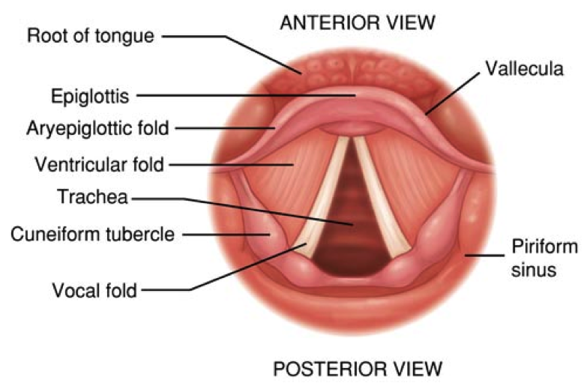
VC

Slide 19
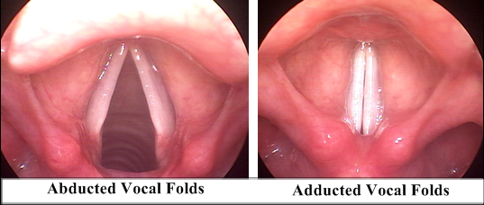

Slide 20
Case study
5 Botox injections. Specialist ENT (2000km away) and Neurologist (visits from 400 km away) perform them.
Voice not normal but spasms are temporarily halted.
Sfx – swallowing issues – water and or food.
Timing of injections for life events - holidays ,work etc and availability .

